Slide 1

Decree-Law nº 35/2012
18 July 2012
Prepared by:
Ana Jeánnie de Côrte-Real
Saturday, 12 July 2014

Slide 2

BUSINESS REGISTRATION REFORMS
IN
TIMOR-LESTE

Slide 3
REGISTRATION PROCESS & ISSUANCE OF AUTHORIZATION TO CONDUCT ACTIVITY AND BUSINESS LICENSE

Slide 4
THE PRINCIPLES OF SERVE
INTEGRATED √
SIMPLER √
LESS / LOW COST √

Slide 5
BUSINESS REGISTRATION – THE JOURNEY
* 2014
- 24 APRIL 2014
1 DAY (Only for SOLE TRADER and SINGLE SHAREHOLDER WITH LIMITED LIABILITY)
- Total Business Registered as of June 2014 (end of June) = 5279
* 2013
JUNE 4, 2013 –
DECEMBER 2014
- 5 DAYS
- ONE-STOP-SHOP
- Total Business Registered: 2847
* 2008 – 2013
Business Registration started in
2008 under Ministry of Justice
Time taken – average of 118 days
Total business registered: 10,929 =
2008 - June 2013

Slide 6
TYPE OF BUSINESSES
ENIN = SOLE TRADER (EMPRESÁRIO EM NOME INDIVIDUAL)
UNIPESSOAL, LDA. = SINGLE SHAREHOLDER WITH LIMITED LIABILITY (SOCIEDADE UNIPESSOAL POR QUOTAS LIMITADA)
LDA. = LIMITED LIABILITY COMPANY (SOCIEDADE POR QUOTAS LIMITADA)
S. A. = JOINT STOCK COMPANY (SOCIEDADE ANÔNIMA)
R. P. = BRANCH OF A FOREIGN COMPANY (REPRESENTAÇÃO PERMANENTE)
E. P. = STATE OWNED ENTREPRISE (EMPRESA PÚBLICA)
S. N. = NATIONAL BRANCH (SUCURSAL NACIONAL)

Slide 7
THE REQUIREMENTS:
* ENIN
1) Business Name (Right & Clear = LEGIBLE)
2) Personal Identification Card (Cartão Eleitoral)
3) Passport + Proof of Residence / Working Visa
(Only for Foreigners) – Ex. Visa of Class I
4) Map of Locality (Main & Branch)
5) Fill up the Forms (SERVE_F_1 – 3_Eng)
6) Legal Constitution or AoA = NOT NECESSARY!
7) Social Capital = ILIMITED / NOT DETERMINED!
8) 3 Copies = Each Document!

Slide 8
* UNIPESSOAL, LDA. & LDA.
1) Legal Constitution or AoA (Business / Commercial
Name – Right & Clear = LEGIBLE):
a. Single AoA, and / or
b. General AoA
c. AoA of each Shareholders (in behalf of Enterprises)
2) Personal Identification Card (Cartão Eleitoral)
3) Passport + Proof of Residence / Working Visa
(Only for Foreigners) – Ex. Visa of Class I
4) Number of Shareholders = Individual & More than
one – 30
5) Social Capital = THERE IS LIMIT!
Min. USD 5,000.00,- – Max. USD 500,000.00,-

Slide 9
* CONTINUED – UNIPESSOAL, LDA. & LDA.
6) Map of Locality (Main & Branch)
7) Admissibility of Firm = ATTENTION!
8) Form of Tax Registry (Business/Individual TIN)
9) Certificate for Debt of Tax = ATTENTION! “THE
DEADLINE”
10) Fill up the Forms (SERVE_F_1 – 3 _Eng)
11) SC > USD 200,000.00,- ~ It is a MUST to have:
a) Even/Pair Administrators (2),
b) Secretary & Single Fiscal / Auditor (1) – It is a MUST.
Note: Single Fiscal / Auditor ≠ Shareholders

Slide 10
* CONTINUED – UNIPESSOAL, LDA. & LDA.
12) 3 Copies = Each Document!
* Note: ~ LDA. = MAY Refer to be as S. A.
Number of Shareholders Min. 3 + Social Capital
Min. USD 50,000.00,-. BUT, depending on the
Shareholders!

Slide 11
* S. A.
1) Legal Constitution or AoA (Business/Commercial Name
– Right & Clear = LEGIBLE):
a. Single AoA, and / or
b. General AoA
c. AoA of each Shareholder (in behalf of Enterprises)
2) Personal Identification Card (Cartão Eleitoral)
3) Passport + Proof of Residence / Working Visa
(Only for Foreigners) – Ex. Visa of Class I
4) Number of Shareholders = Min. 3
5) Social Capital = NO LIMIT!
Min. USD 50,000.00,- & NO MAX. VALUE / AMOUNT.

Slide 12
* CONTINUED – S. A.
6) Map of Locality (Main & Branch)
7) Admissibility of Firm = ATTENTION!
8) Form of Tax Registry (Business/Individual TIN)
9) Certificate for Debt of Tax = ATTENTION! “THE
DEADLINE”
10) Fill up the Forms (SERVE_F_1 – 3 _Eng)
11) It is a MUST to have: Administrators = Uneven/
Impair (3) – Administrator 1 & 2 Vocal / Vices.
Secretary & Single Fiscal / Auditor (1)
Note: Single Fiscal / Auditor ≠ Shareholders

Slide 13
* CONTINUED – S. A.
12) Submission of Financial Report (all related
expenses) – To competent Financial Institution
13) 3 Copies = Each Document!

Slide 14
* R. P. = S. I.
1) Legal Constitution or AoA (Business/Commercial Name
– Right & Clear = LEGIBLE):
a. General AoA
2) Letter of Deliberation / Act or Minutes of Actual or
Latest General Assembly – Description on the interest
to have R. P. at preset country & introduce
the Person as Official & Legal Representative, etc. –
3) Personal Identification Card (Cartão Eleitoral)
4) Passport + Proof of Residence / Working Visa
(Only for Foreigners) – Ex. Visa of Class I
5) Social Capital = NO LIMIT!
Min. USD 5,000.00,- & NO MAX. VALUE / AMOUNT.

Slide 15
* CONTINUED – R. P. = S. I.
6) Map of Locality (Present Locality)
7) It is a MUST to have: Proof from the RDTL Embassy
Office in Origin Country & translate to Portuguese or
Tétum (should attached all original documents from the
origin country)
8) Fill up the Form (SERVE_F_1 – 3 _Eng)
9) 3 Copies = Each Document!

Slide 16
* S. N.
1) Depending the Type of Business (ENIN; Unipessoal,
Lda.; Lda.; S. A. ; & R. P.)
2) Letter of Request to Establish an a Branch
(National or International)
3) Amendment Letter or to modify address of previous
office – Old Legal Constitution / AoA
4) Request Letter for the Establishment of a New
Branch (National or International)
5) Personal Identification Card (Cartão Eleitoral)

Slide 17
* CONTINUED – S. N.
6) Passport + Proof of Residence/Working Visa
(Only for Foreigners) – Ex. Visa of Class I
7) Map of Locality (Office or New Address for Business)
Note: New Document of Request + Annex with all
documents as registered at previous.

Slide 18
NOT TO USE / APPLY:
Names that are prohibited by Law to use as “BUSINESS NAME”:
TIMOR-LESTE
Name that is related to CULTURE (Cultural Practices) & is HISTORIC
Name that is SIMILAR or an EXISTED NAME
Name that has NEGATIVE CONNOTATION with bad words and insulting expression

Slide 19
WHO CAN REGISTER?
OWNER
DIRECTOR
REPRESENTATIVE (POWER OF ATTORNEY SHALL BE ATTACHED)
“Please Be Aware” – To register a Business or a Commercial
Company A RESIDENT DIRECTOR shall be appointed!

Slide 20
Criteria's to be appointed as a RESIDENT DIRECTOR
IF A TIMORESE –
      17 YEARS AND ABOVE;
      HOLDER OF ID CARD OR ELECTORAL CARD
IF A FOREIGNER –
      17 YEARS AND ABOVE (Chapter 118º of the Civil Code of Timor-Leste)
      HOLDER OF VALID PASSPORT
      HOLDER OF VALID WORK VISA AND/OR RESIDENT PERMIT

Slide 21
HOW TO REGISTER?
COMPLETE THE APPLICATION FORM (SERVE REGISTRATION FORMS – SERVE_F_1_13_ENG) TOGETHER WITH THE FOLLOWING:
    COPY OF IDENTITY CARD OR PASSPORT (3 COPIES)
    ADDRESS OF BUSINESS’S OFFICE (SHOWN ON A MAP: 3 COPIES)
    ACT OF ASSOCIATION (ESTATUTO) – 3 COPIES (NOT APPLICABLE
    FOR ENIN)
    POWER OF ATTORNEY (IF THE SUBMISSION OF DOCUMENT IS DONE
    THROUGH A REPRESENTATIVE)
    SUBMIT BEFORE 12:00 NOON
    DOCUMENTS ARE IN ORDER
    FREE REGISTRATION

Slide 22
ISSUANCE OF CERTIFICATE
AND APPROVAL (Decree-Law nᵒ 35/2012)
CERTIDÃO DO REGISTO COMERCIAL (CRC) / BUSINESS
REGISTRATION CERTIFICATE (BRC) /
CERTIFICADO DO REGISTO COMERCIAL (CRC) / CERTIFICATE
FOR BUSINESS REGISTRATION (CRC)
AUTORIZAÇÃO PARA EXERCÍCIO DE ACTIVIDADE /
AUTHORIZATION TO CONDUCT ACTIVITY
LICENÇA COMERCIAL / BUSINESS LICENSE

Slide 23
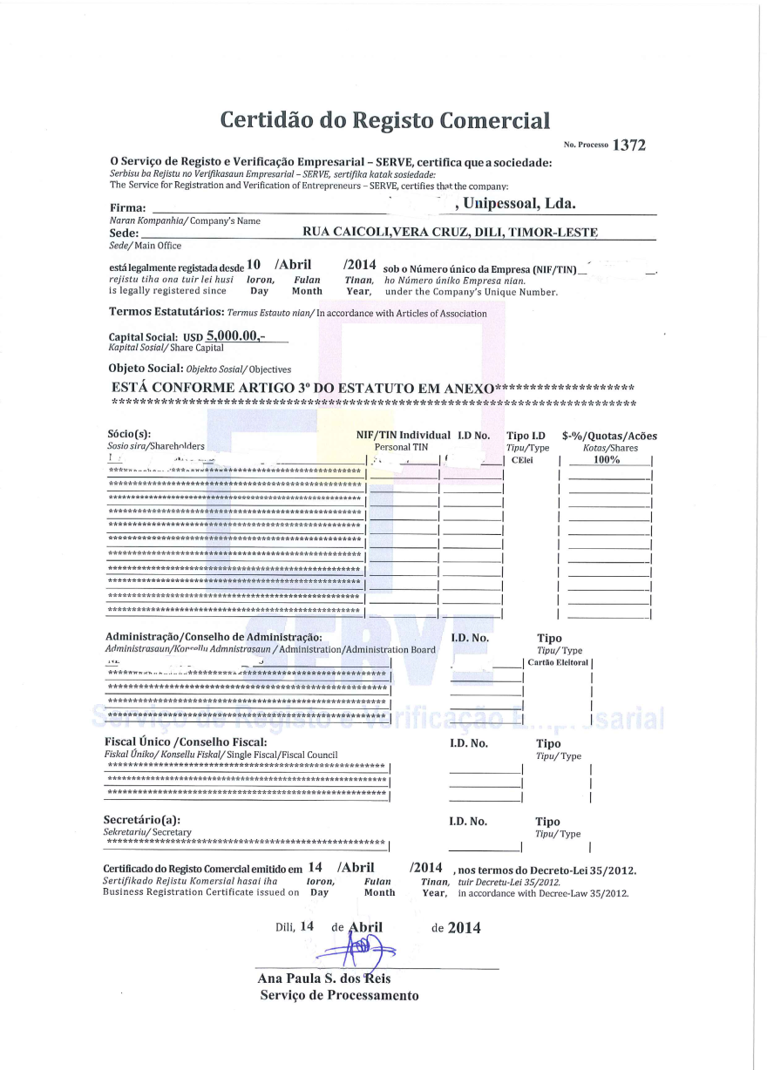


Slide 24
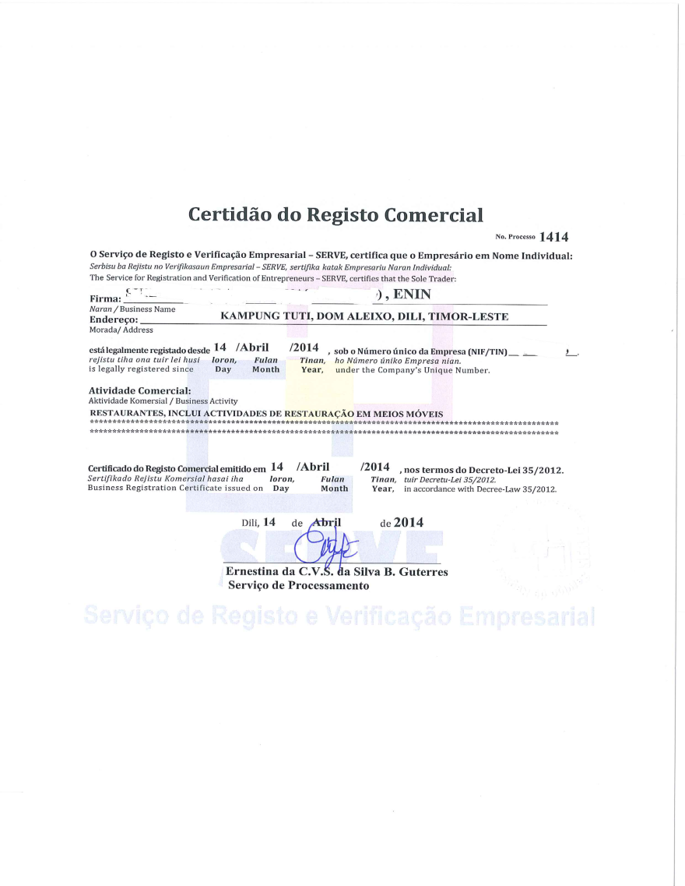

Slide 25
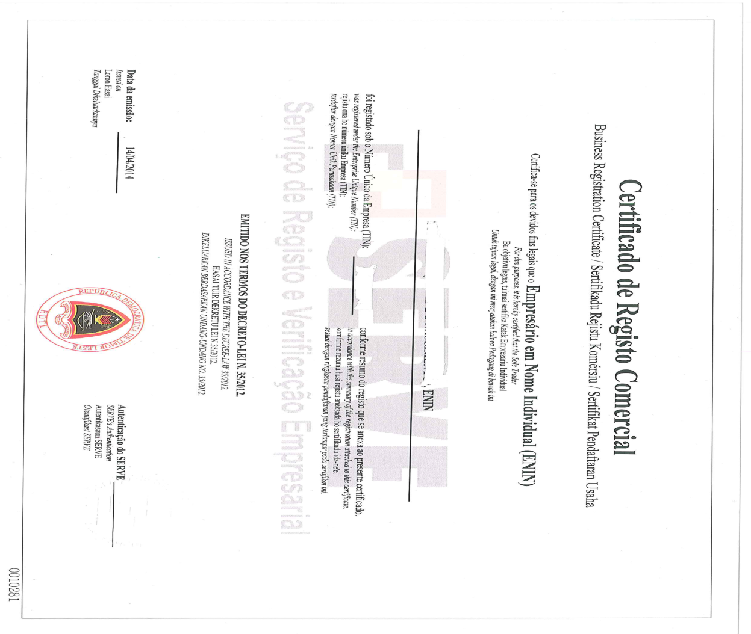

Slide 26
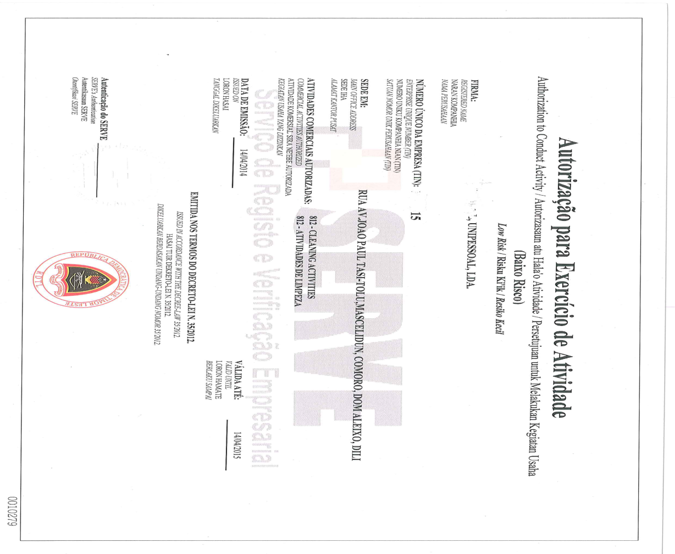

Slide 27
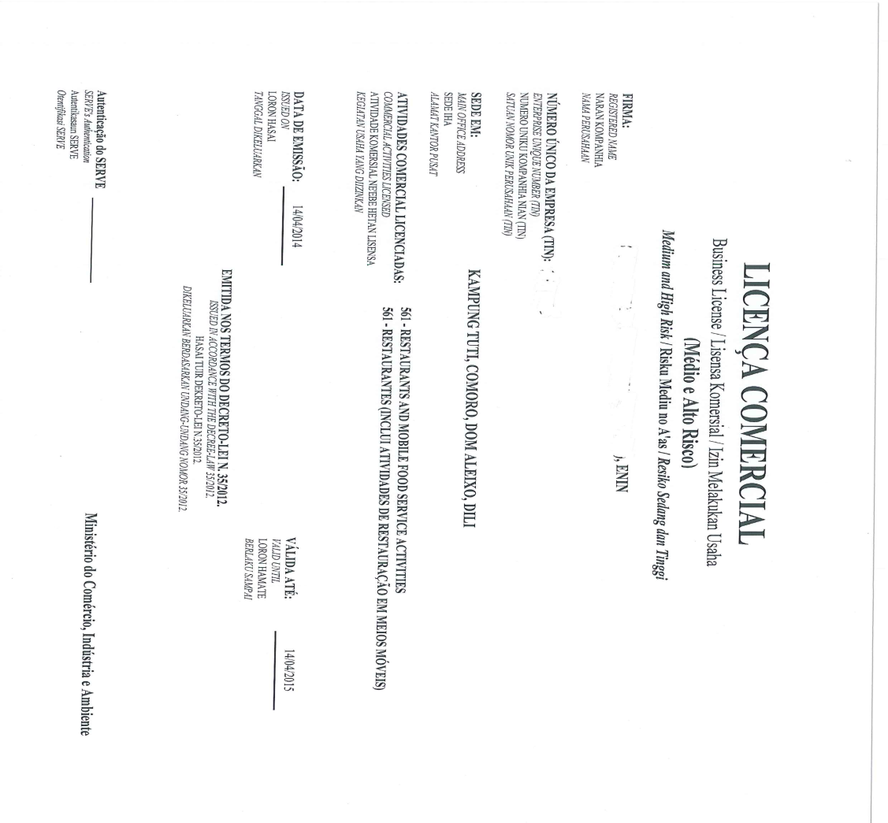

Slide 28
OTHER REGULATION
SERVE is adopted the ISIC Code to rules the
ECONOMIC ACTIVITIES (EC or CAE) to be performed
by the Companies.
Different EC has different code and they have
different categories in terms of the LEVEL OF RISKS.
For the EC’s with LOW RISKS – SERVE can immediately
issue the AUTHORIZATION TO CONDUCT THE ACTIVITY
and for the EC’s with HIGH RISKS – they need of
BUSINESS LICENSE.

Slide 29
INTERNATIONAL STANDARD – ISIC CODE

Slide 30
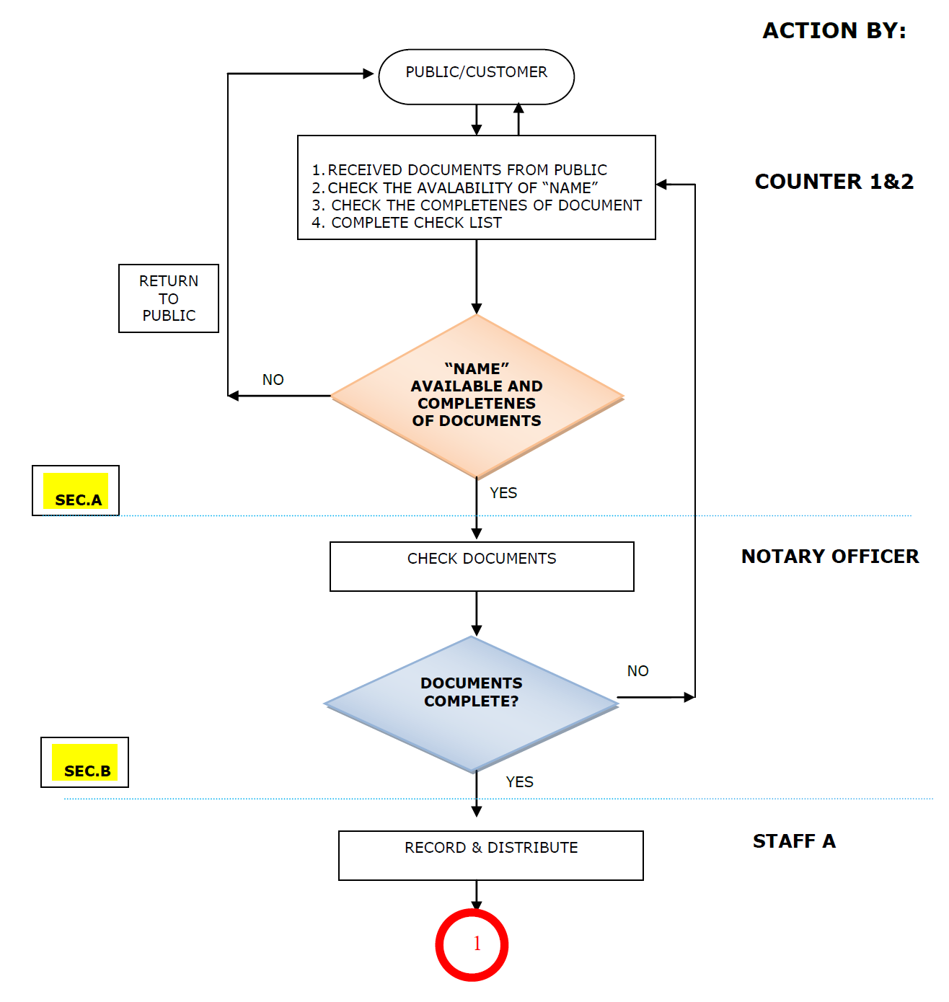
PROCESS FLOW

Slide 31
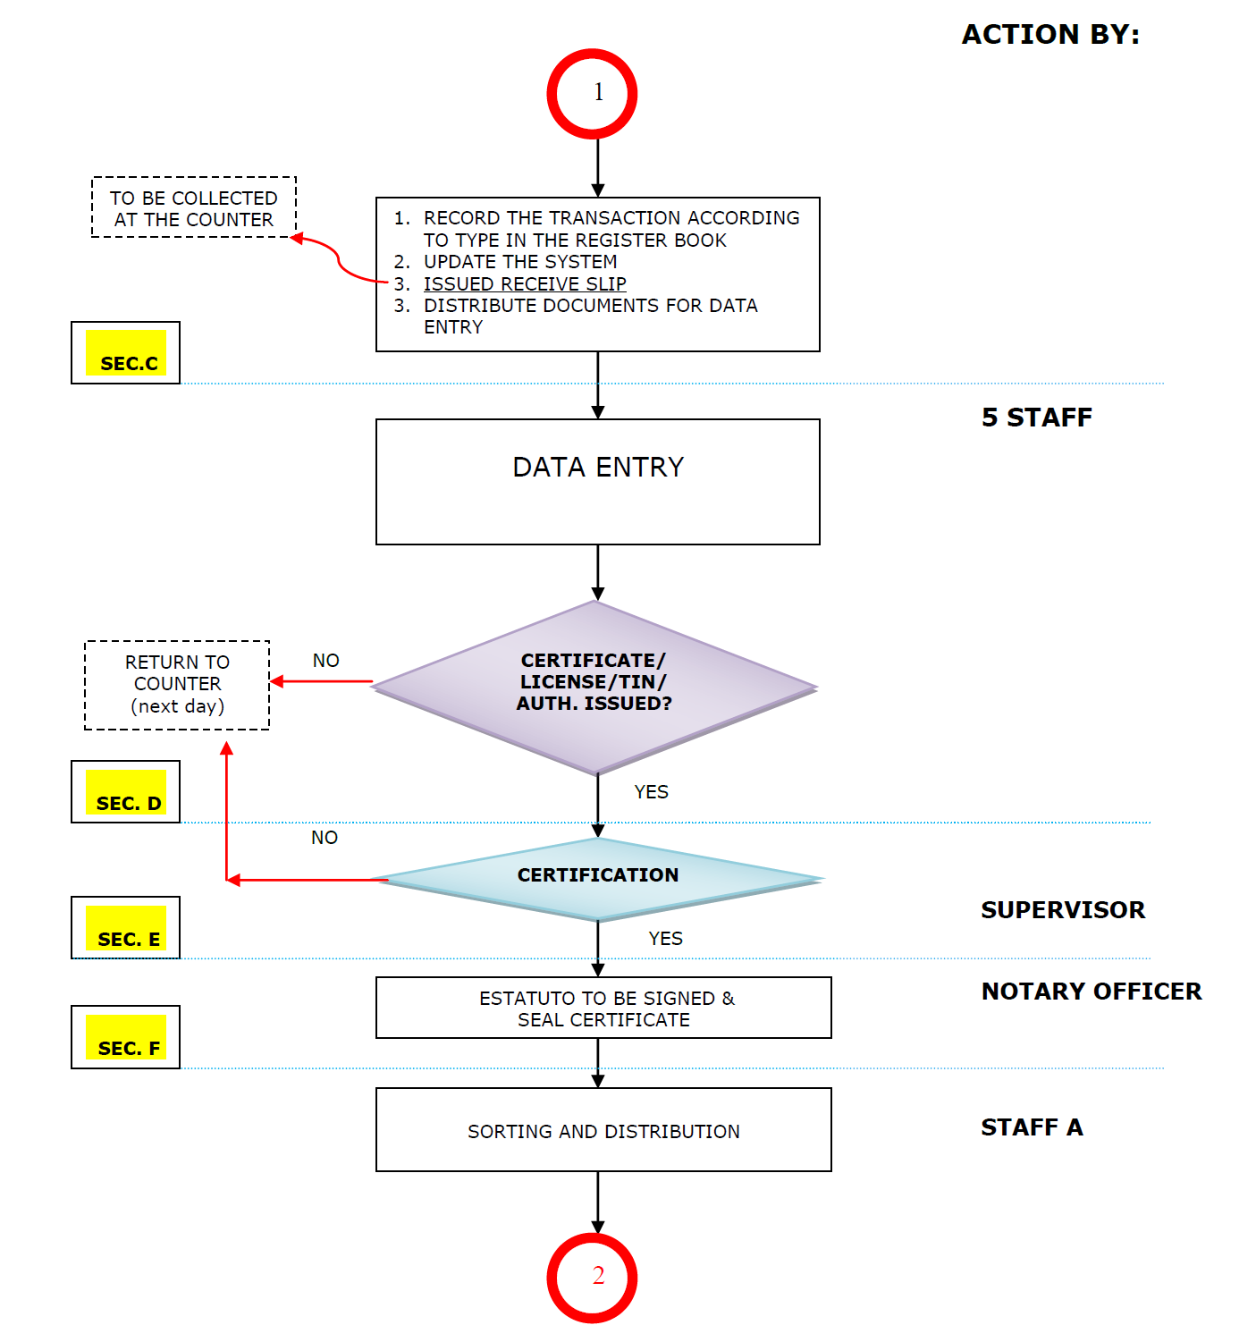
CONTINUED – PROCESS FLOW

Slide 32
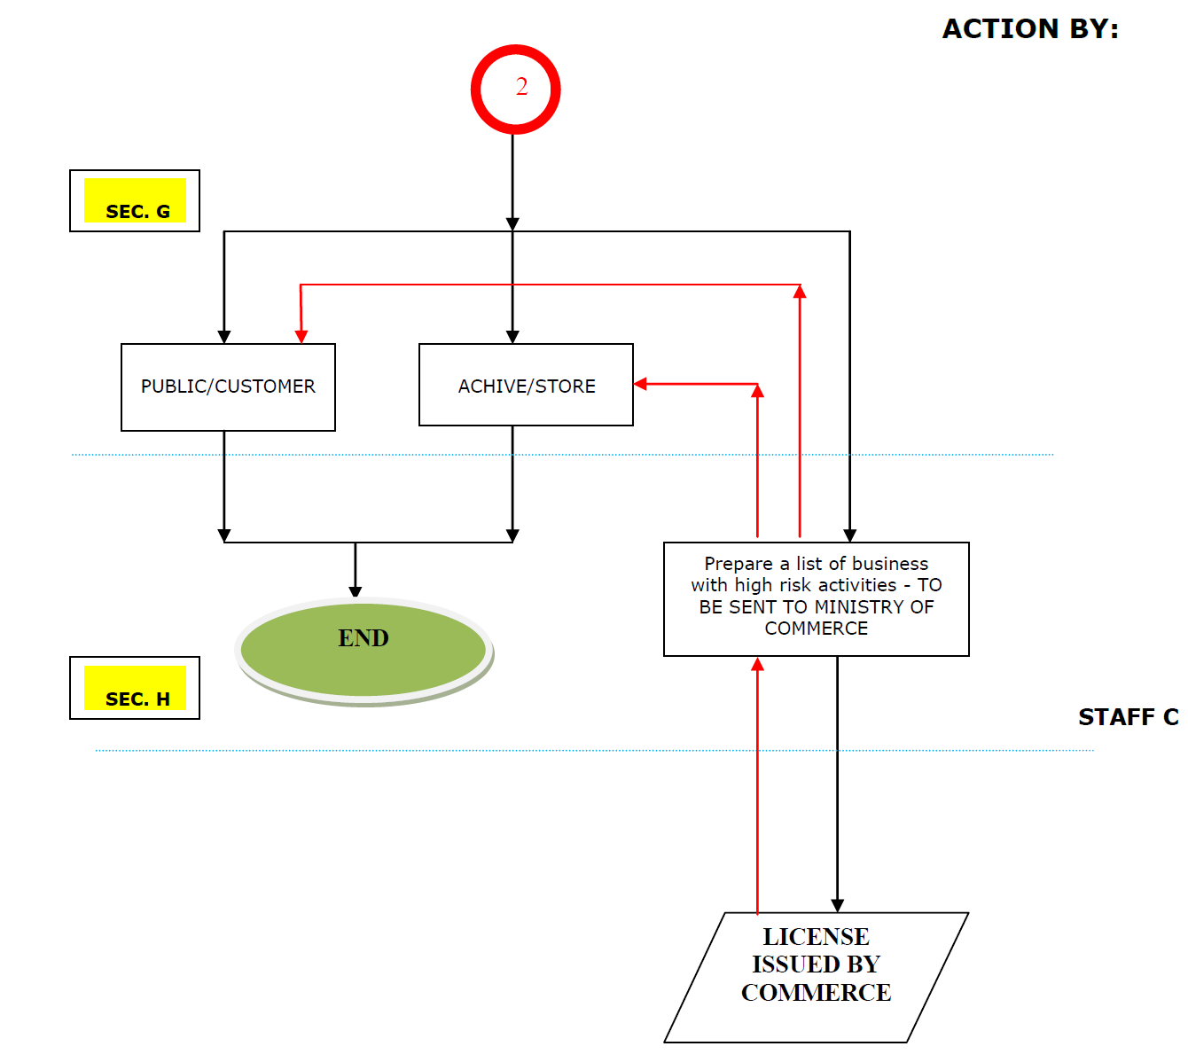
CONTINUED – PROCESS FLOW

Slide 33
MOVING FORWARD
To open SERVE’s Branch office in other Districts –
OECUSSE (AMBENO) is the first district.
To have SERVE’s own integrated system, including
online registration services – DATA-BASE SYSTEM AND
“PMS”.
To improve and maintain the quality of service
delivery that meets customer's needs.

Slide 34
* ARCHIVES – CABINET ARRANGEMENT
Divided into types of registration and cabinet code: -
TYPES | CABINET CODE
UNIPESSOAL, LDA. | A
ENIN | B
LDA. | C
S. A. | D
R. P. | E
DISSOLVED | F

Slide 35
* CONTINUED – ARCHIVES – CABINET ARRANGEMENT
Each cabinet has 4 drawers
Display each drawers with reference as follows –cabinet code, cabinet number / drawer number followed by TIN Group Number, example: -
    A1/1 1184000 1184999
    A1/2 1185000 1185999
    A1/3 1186000 1186999
    A1/4 1187000 1187999
Cabinet Code : A for Unipessoal, Lda.
Drawer No.
TIN Group Number
Cabinet No.

Slide 36
Q & A / CONSULTATION – FOR DETAILED INFORMATION
SERVE Website: www.serve.gov.tl – Samples of AoA’s, SERVE
Registration Forms, the requirements for business
registration, and Power of Attorney.
You can also vizit us at Office Address: Obrigado Barracks
2, Matadouro, Díli, Timor-Leste. Tel.: 331 1315

Slide 37
THANK YOU
FOR YOUR ATTENTION!

